Slide 1




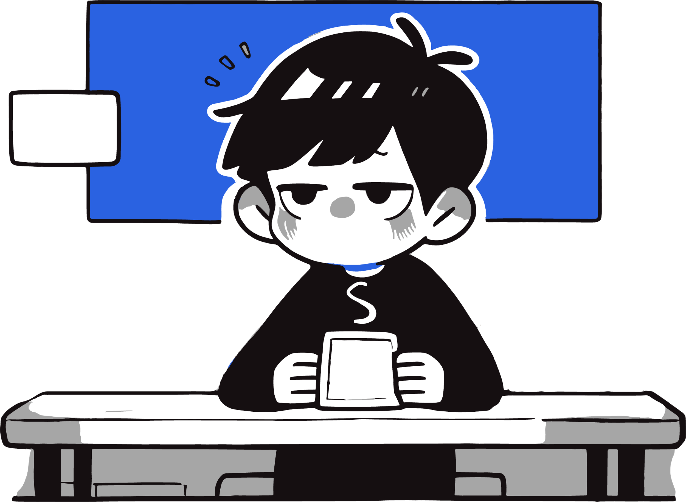









Presentation
GAME REPORT
Game
GAME REPORT
Project Presentation
GAME REPORT
GAME REPORT
Team:
High-Education Talent Wholesale Market
WORK REPORT

Slide 2




C
O
N
T
E
N
T
Table
01
Team Introduction
02
Project Overview
03
Demo

Slide 3

Presentation
工作概述
PART ONE PART ONE PART ONE
PART ONE PART ONE PART ONE
01
Team
PART ONE PART ONE PART ONE
PART ONE PART ONE PART ONE
PART ONE PART ONE PART ONE
PART ONE PART ONE PART ONE

Slide 4




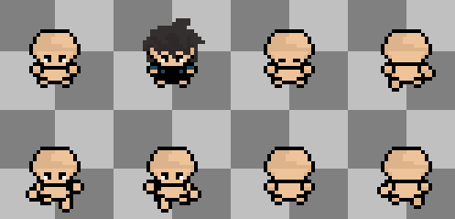
Presentation
工作概述
Team Introduction: High-Education Talent Wholesaler
Planning:
Liu Yonglin (Sun Yat-sen University)
Programming:
Feng Jiaqi (Taylor's University)
Zhang Huilin (Guangxi University)
Li Hongwen (Fujian Jiangxia University)
Art:
Yan Jintao (Tianjin Electronic Information Vocational Technology College)

Slide 5

Presentation
工作亮点
PART TWO PART TWO PART TWO
PART TWO PART TWO PART TWO
02
PART TWO PART TWO PART TWO
Project Overview
PART TWO PART TWO PART TWO
PART TWO PART TWO PART TWO
PART TWO PART TWO PART TWO

Slide 6
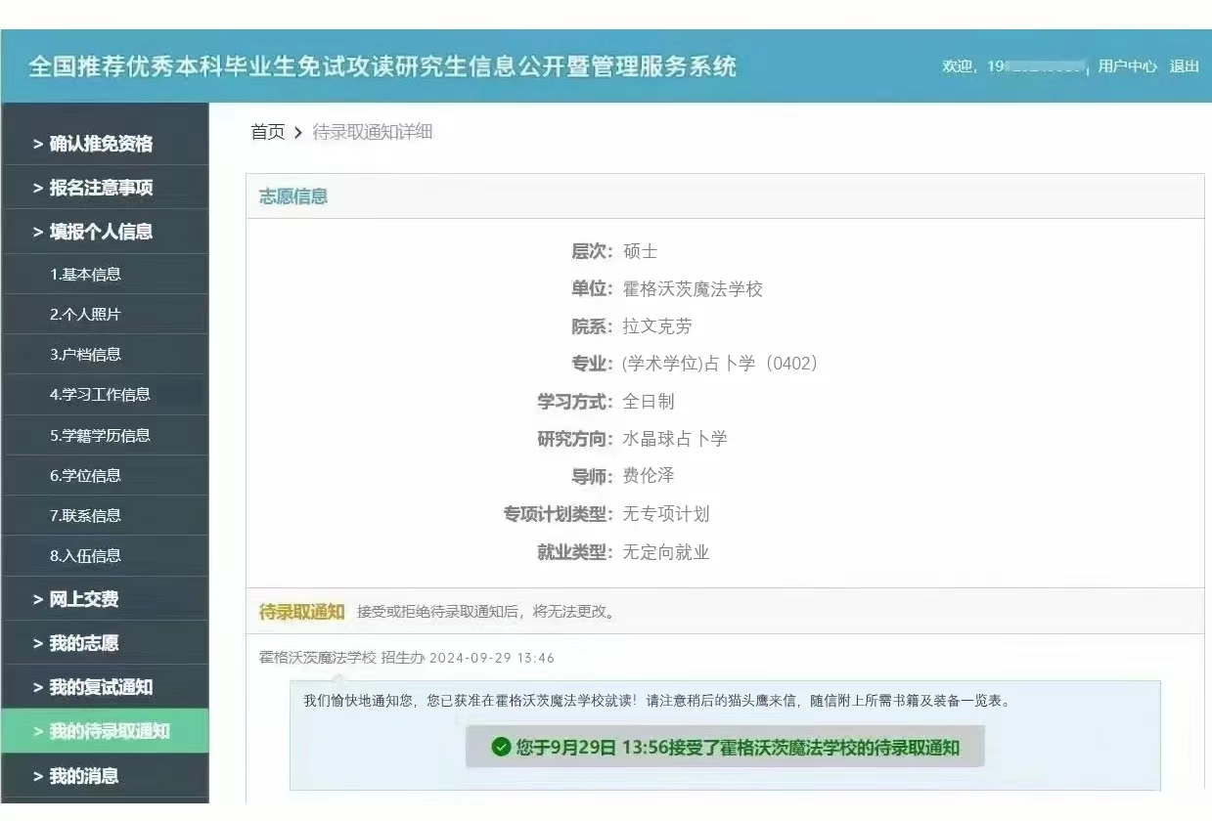
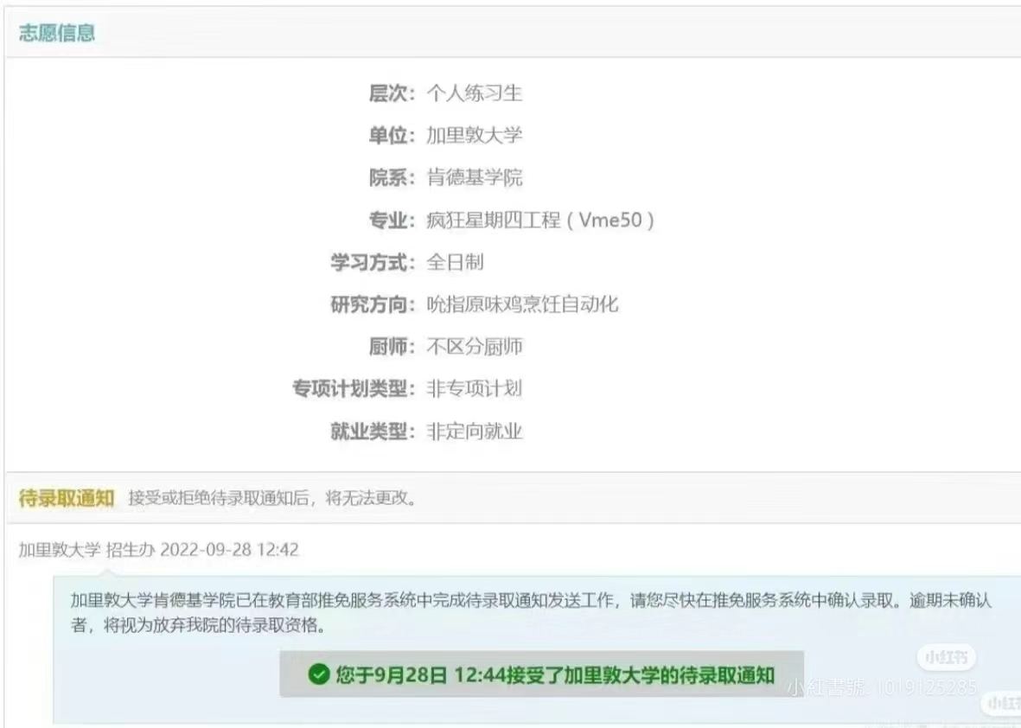
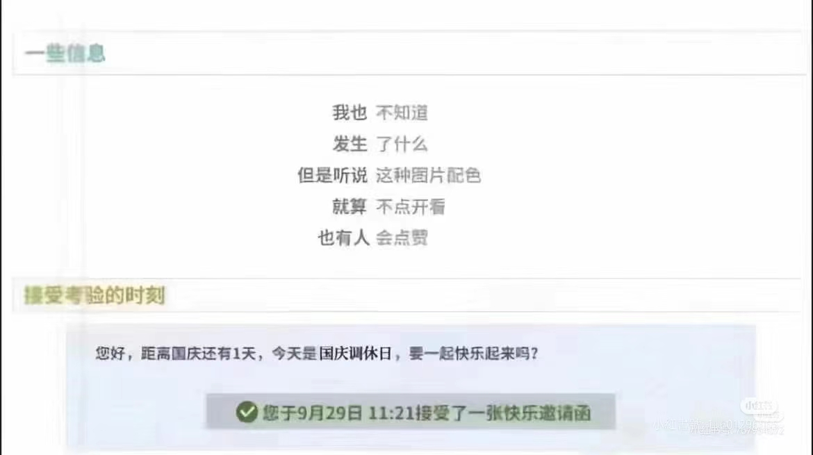
Presentation
China's Recommended Exemption for Postgraduate Studies Website
未来计划

Slide 7




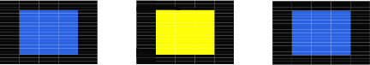
Presentation
工作亮点
《Code: graduate》
Game Tags：
Game Theme and Background: Modern Campus, Postgraduate Recommendation, Academic Pressure, etc. Game Introduction: Meritocracy is highly prevalent nowadays, and securing a postgraduate recommendation seems to have become a natural choice for a better future. You will play as a university student, starting from the beginning of the academic year, free from the hardships of the college entrance exam, and progressing toward graduation. Throughout the journey, you will encounter a variety of people and events, engage in key item collection, dialogue choices, and interactive challenges, ultimately leading to different endings.
RPG
Narrative
Pixel
Exploration

Slide 8
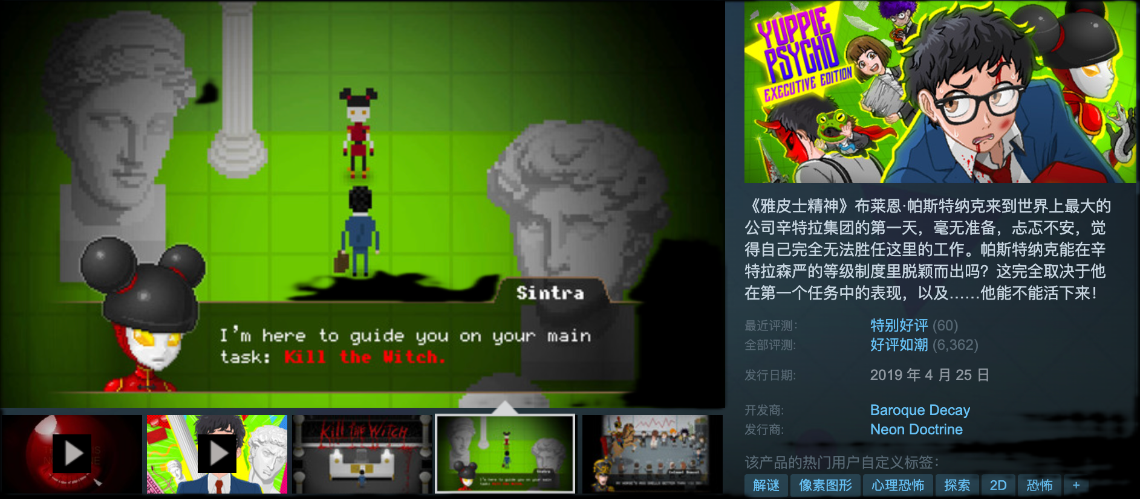
Presentation
未来计划
References：《Yuppie Psycho》

Slide 9
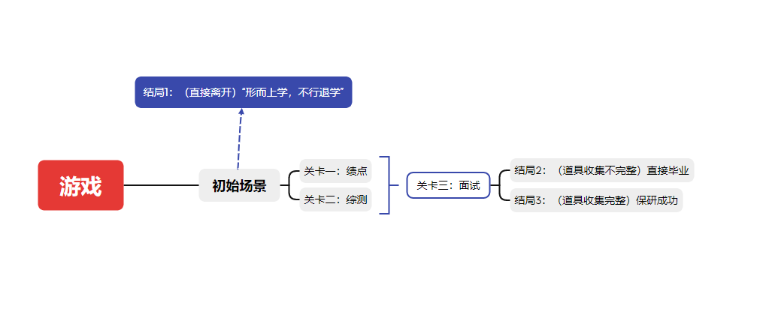
Presentation
未来计划
Proposal: Topic — Elements — Specific Level Design
Ending 1: (Leave Directly) "Metaphysics, No Way, Drop Out"
Level 3: Interview
Initial
Initial Scene
Ending 2: (Incomplete Item Collection) Direct Graduation Ending 3: (Complete Item Collection) Successful Postgraduate Recommendation
Level 1: GPA Level 2: Comprehensive Evaluation

Slide 10

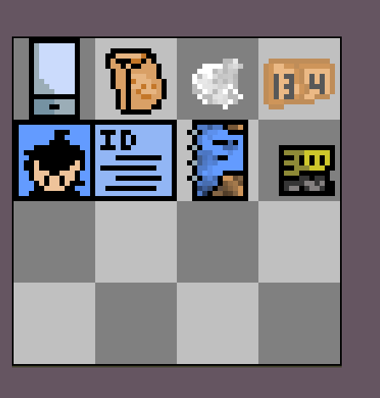
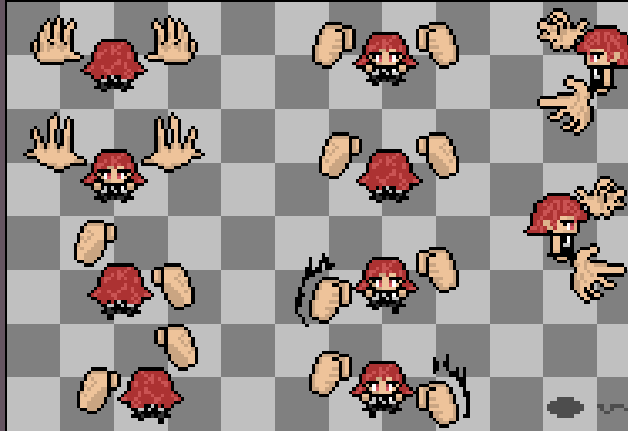
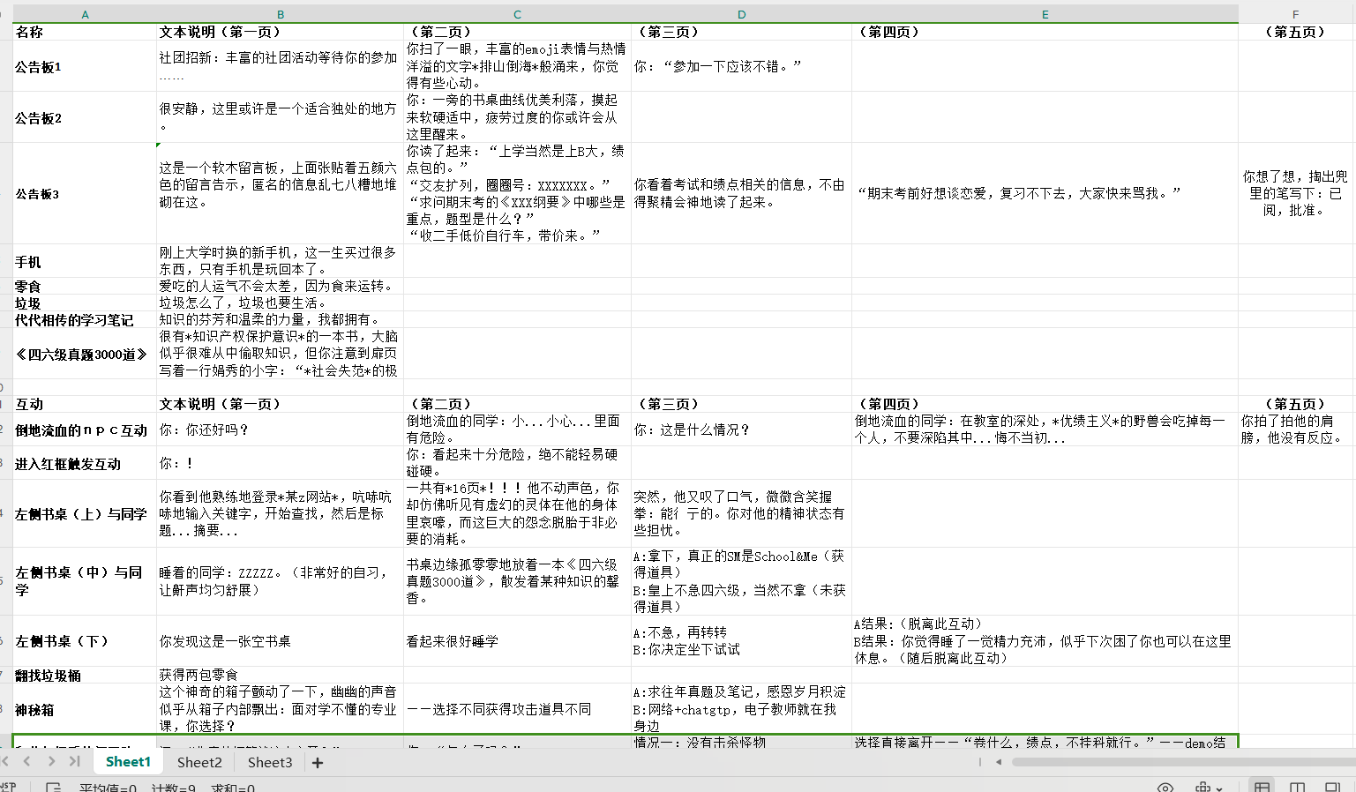
Presentation
未来计划
Art Assets
Text and Item Design

Slide 11
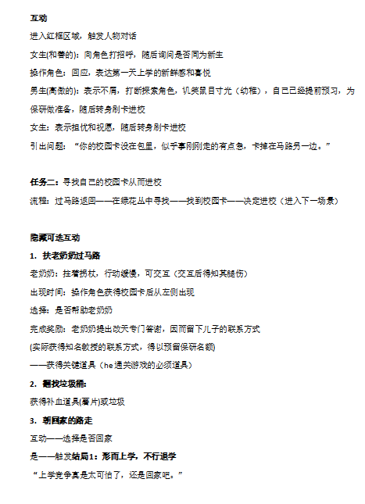
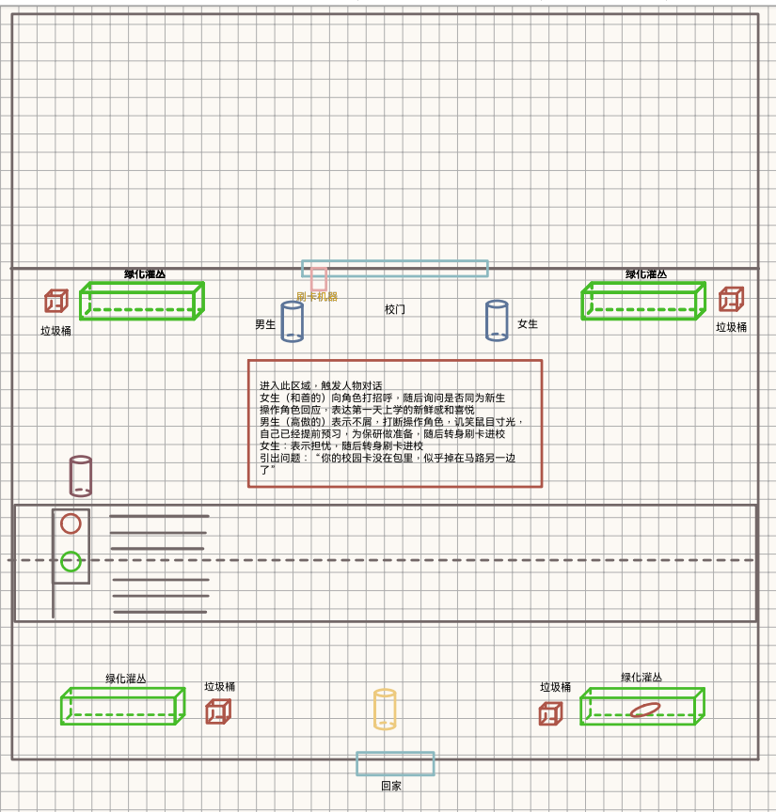
Presentation
未来计划
Process Design Draft
Planning Proposal
Gameplay: Interactive Narrative + Combat
Interaction Design Draft

Slide 12
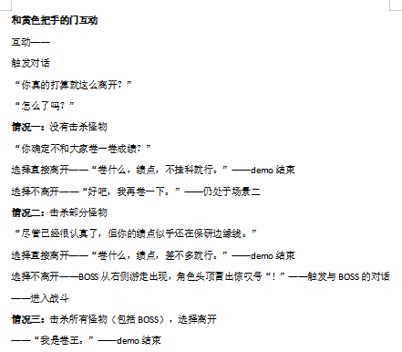
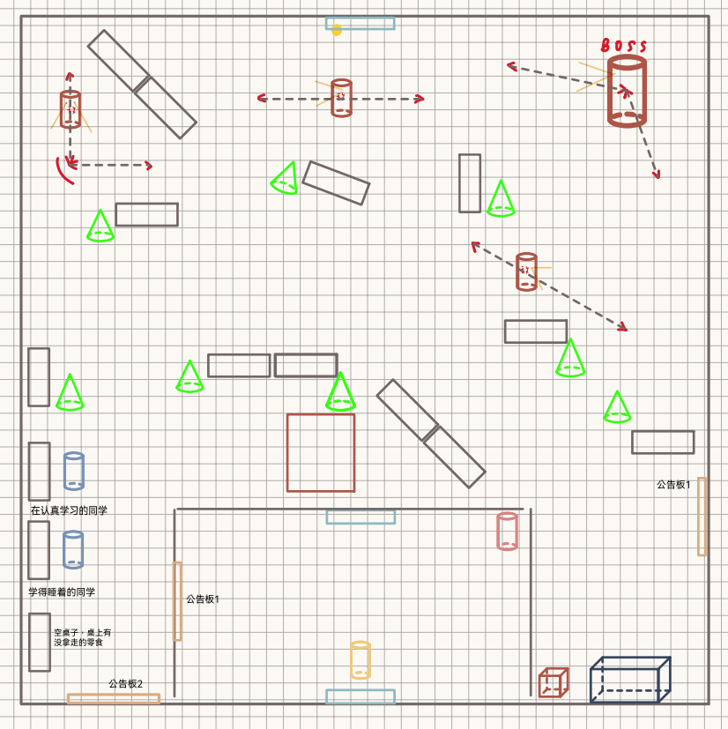
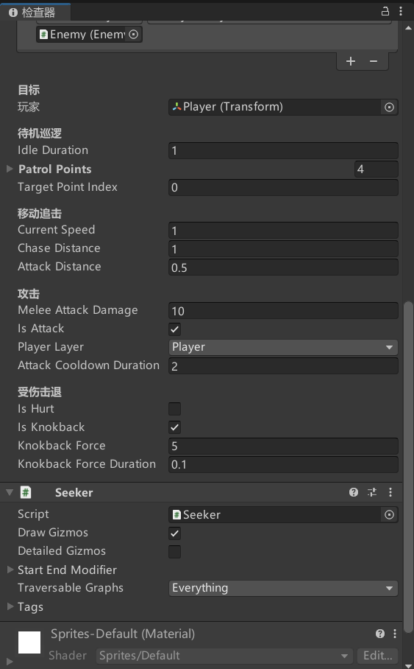
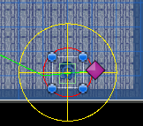
Presentation
未来计划
Enemy and Combat Judgment Implementation
Situation Forecast

Slide 13

Presentation
工作反思
PART THREE PART THREE PART THREE
03
PART THREE PART THREE PART THREE
demo
PART THREE PART THREE PART THREE
PART THREE PART THREE PART THREE
PART THREE PART THREE PART THREE
PART THREE PART THREE PART THREE

Slide 14
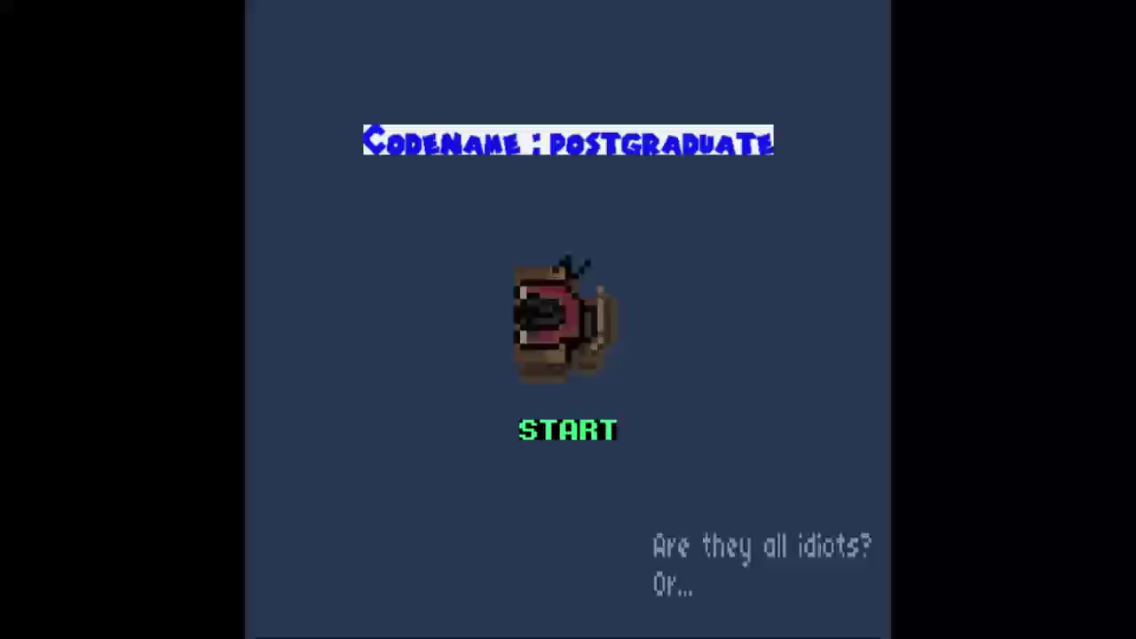
Presentation
未来计划
DEMO Video Presentation

Slide 15
Presentation
Thank You for Watching
Presentation Team: High-Education Talent Wholesaler

